Slide 1
Guessing Game
Can you guess my favorite things?

Slide 2
Favorite Color?
A
A
A
B
Red
Yellow
C
D
A
A
Green
Blue

Slide 3




Favorite Drink?
A
A
A
B
Milk
Cola
C
D
A
A
Apple Juice
Tea

Slide 4
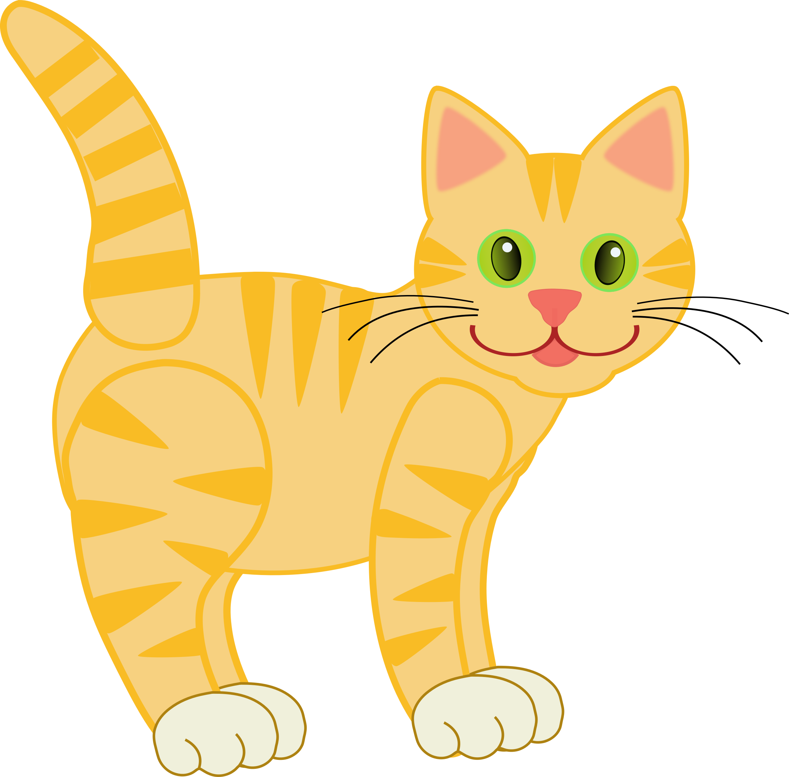


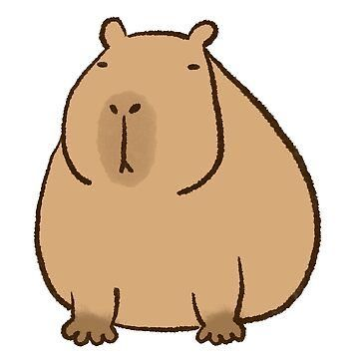
Favorite Animal?
A
A
A
B
Cat
Dog
C
D
A
A
Penguin
Capybara

Slide 5




Favorite Season?
A
A
A
B
Summer
Fall
C
D
A
A
Winter
Spring

Slide 6
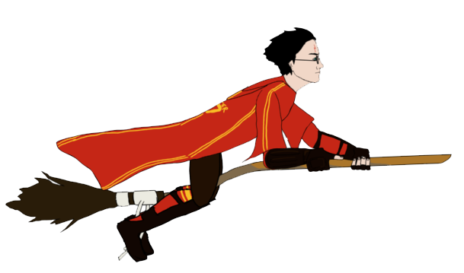

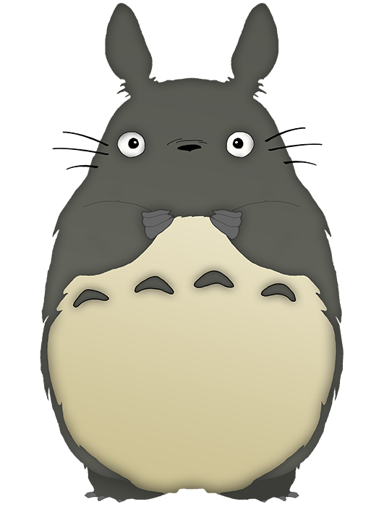
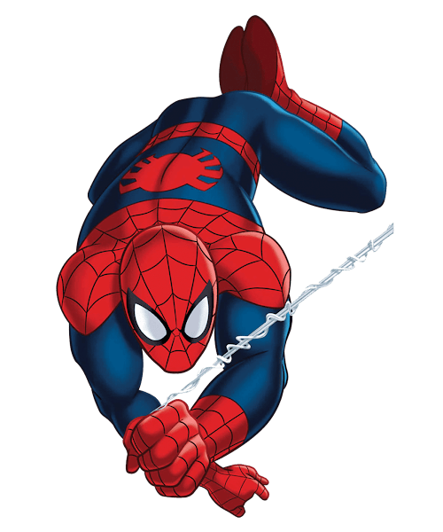
Favorite Movie?
A
A
A
B
Harry Potter
Star Wars
C
D
A
A
Spiderman
Totoro

Slide 7


Favorite Hobby?
A
A
A
B
Music
Reading
C
D
A
A
Cooking
Colorguard

Slide 8
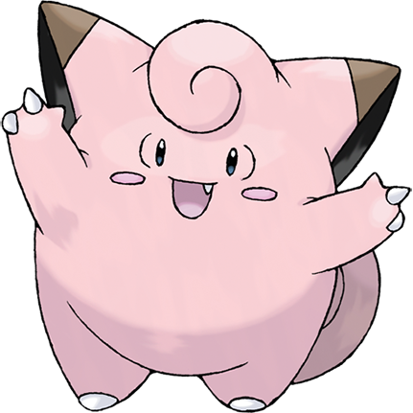
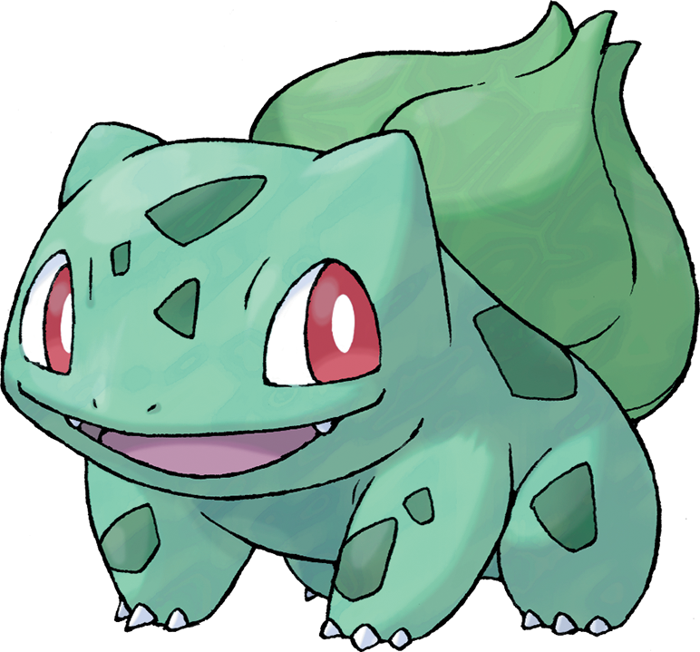
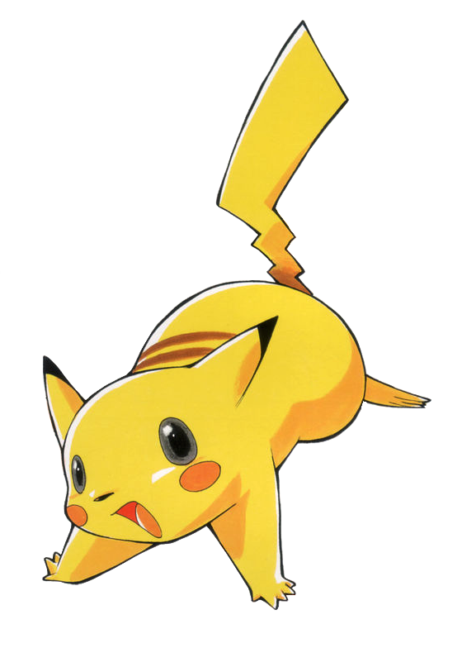
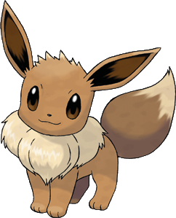
Favorite Pokémon?
A
A
A
B
Bulbasaur
Clefairy
C
D
A
A
Pikachu
Eevee

Slide 9

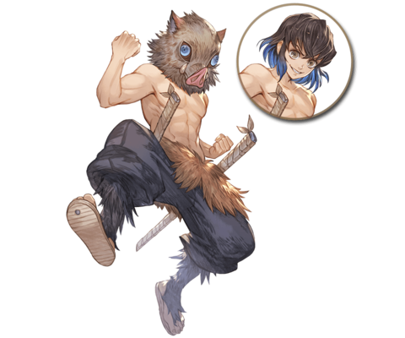
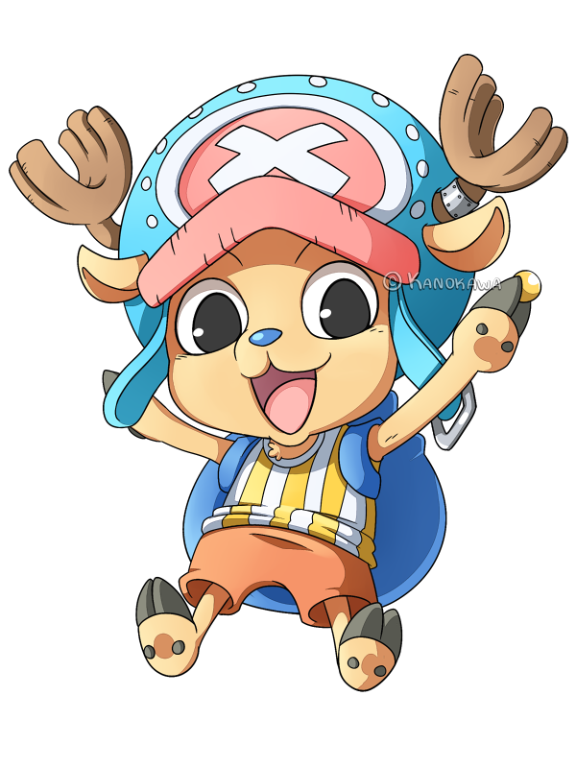
Favorite Anime?
A
A
A
B
Pokémon
Haikyuu!!
C
D
A
A
One Piece
Kimetsu no Yaiba

